Slide 1
CN8861 Network Management Lecture-4
Dept. of Electrical & Computer Engineering
Ryerson University

Slide 2
Overview
Agent Extension
Distributed Management
Service Level Monitoring
NNM Scalability and Distribution

Slide 3
Section 1 Agent Extension

Slide 4
Motivation for Agent Extension
Managed devices are often collections of manageable components.
Each component provides instrumentation for the MIB module it implements.
There is a real need to dynamically extend the set of managed objects within a node.
The SNMP framework does not describe how the set of managed objects supported by a particular agent can be changed dynamically
A standard protocol for agent extensibility addresses this problem.
RFC 2741 (AgentX Protocol)

Slide 5
Agent Extension
Facilitates extension of SNMP Agents with dynamic addition of new MIB module implementations.
Separates SNMP protocol engines from MIB Instrumentation.
Maintains transparency to Management Stations.

Slide 6
Agent Extension Framework
In the Agent Extension framework, the SNMP agent is further defined to consist of:
a master agent, which sends and receives SNMP protocol messages but has little or no direct access to management information.
one or more subagents that have access to management information.
a protocol (agentX) that operates between the master agent and subagents, permitting subagents to connect to the master agent

Slide 7
Agent Extension Design Features
Master agents are concerned with
SNMP protocol operations and the translations to and from AgentX protocol operations
Subagents are exclusively concerned with management instrumentation
Subagents are not aware of any other subagents.
A single subagent is "authoritative" for a particular region of the MIB
"region" may extend from an entire MIB down to a single object- instance

Slide 8
Agent Extension Framework
SNMP
Master Agent
Protocol Operations
AgentX
Sub-agent
Sub-agent
Sub-agent
MIB
MIB
MIB

Slide 9
Agent Extension – Master Agent
Master agent performs following functions
sends and accepts SNMP protocol messages.
accepts registration of MIB regions by subagents.
sends and receives AgentX protocol messages to access management information based on the current registry of MIB regions.
provides instrumentation for certain MIB objects.
forwards notifications on behalf of subagents.

Slide 10
Agent Extension – Sub-Agent
A sub-agent performs following functions
initiates AgentX sessions with the master agent
registers MIB regions with the master agent
provides instrumentation for MIB regions
performs management operations on variables
initiates notifications

Slide 11
Agent Extension – VarBind Splitting
Sub-agent
MIB
A
Sub-agent
A
B
C
Master Agent
SNMP
MANAGER
MIB
B
C
Sub-agent
MIB

Slide 12
Agent Extension – OID Registration
MIB Registration
Example: REGISTER (mib-2)
RANGE Registration
Example: REGISTER (mib-2.interfaces, mib-2.tcp)

Slide 13
Section 2 Distributed Management

Slide 14
RFC References – Distributed Management
RFC 3165, “Definitions of Managed Objects for the Delegation of Management Scripts”
RFC 3231, “Definitions of Managed Objects for Scheduling Management Operations”
RFC 2982, “Distributed Management Expression MIB”

Slide 15
Overview
Distributed Management System
Characteristics
Technologies
Distributed Management MIBs
Script MIB
Schedule MIB
Expression MIB
Event MIB

Slide 16
Distributed Management Systems - Characteristics
Complexity of Management Tasks
In a centralized system, the central manager carries out the entire management task.
In a weakly distributed system, a complex task is assigned to the top level manager, whereas mid-level managers execute simple tasks.
In a strongly distributed system, the distribution of complexity of management tasks becomes more balanced.
Strongly distributed systems decentralize management processing to each and every network element; management tasks are no longer confined to managers.

Slide 17
Distributed Management Systems – Characteristics (contd.)
Computational load on the top-level manager is reduced by delegating functions elsewhere.
Mid-level managers manage a large subset of devices.
The communication load on the network is reduced.
By locating mid-level managers as close to the devices as possible, only processed data moves between managers.
With dynamic delegation, processing is moved across the network, rather than data.
Dynamic delegation refers to where management tasks can be assigned and changed dynamically.
IETF Script and Schedule MIBs
Storage requirements at the executing nodes is reduced.
By dynamic delegation of management functionality, only current active procedures need to be stored.

Slide 18
Distributed Management MIBs
IETF had proposed several standard MIBs used to realize Distributed Managers.
The DISMAN MIBs of particular interest include:
Schedule MIB
Script MIB
Expression MIB
Event MIB

Slide 19
IETF Distributed Management MIBs
internet
{.iso.org.dod 1}
mgmt
{internet 1}
mib-2
{mgmt 1}
Schedule MIB
Script MIB
Event MIB
Expression MIB
{mib-2 63}
{mib-2 64}
{mib-2 88}
{mib-2 90}

Slide 20
Script MIB
Script MIB defines managed objects for delegation of management functions.
Management functionality is delegated as scripts that are transferred to the location where they are executed.
Scripts can be started remotely, arguments can be passed to them, and results can be returned.

Slide 21
Script MIB - Capabilities
Transfer management scripts to a distributed manager.
Initiate, suspend, resume or terminate management scripts.
Transfer arguments for management scripts.
Monitor and control running management scripts.
Transfer the results produced by the management scripts.

Slide 22
Script MIB – Script Transfer
Every script is identified by an administratively assigned name.
Two ways to transfer management scripts to a distributed manager:
Push Model: The high-level manager pushes the script to the distributed manager.
Pull Model: The manager tells the distributed manager the location of the script and the distributed manager retrieves the script.
The Script MIB also supports management scripts that are hard-wired into the Script MIB implementation.
Scripts are stored in an non-volatile storage. This allows a distributed manager to restart scripts.

Slide 23
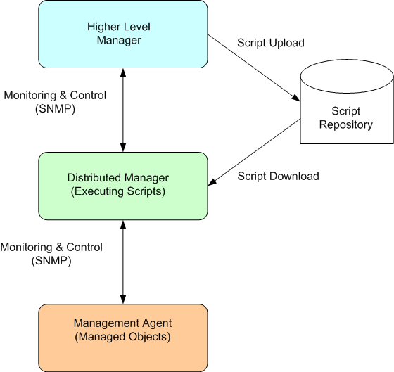
Script MIB – Framework

Slide 24
Script MIB – Script Transfer
The ‘push model’ is realized by a table which allows a manager to write scripts by sending a sequence of SNMP set requests.
The ‘pull model’ is realized by the use of URLs that point to the script source.
The manager writes the URL by an SNMP set request.
The distributed manager is then responsible for retrieving the script using the protocol specified in the URL (such as FTP or HTTP).

Slide 25
Script MIB – Script Execution
The Script MIB permits execution of management scripts:
Arguments to scripts are passed as OCTET STRING values.
Scripts often return a single result value (an OCTET STRING value)..
Scripts can also export complex results via returning a URL that points to the script output.
Script arguments and results do not have any size limitations other than the limits imposed by the SNMP protocol.
When runtime errors terminate active scripts, an exit code and an error message is left in the MIB.
Script execution can be suspended, resumed, or aborted.
A history of finished scripts is kept in the MIB.

Slide 26
Script MIB
scriptMIB
{.iso.org.dod.internet.mgmt.mib-2 64}
smNotifications
smObjects
{scriptMIB 2}
smConformance
{scriptMIB 1}
{scriptMIB 3}
smTraps
smScriptException
smScriptAbort
smExtsnTable
smScriptResult
smScriptObjects
smRunObjects
smLangTable
smScriptTable
smCodeTable
smLaunchTable
smRunTable

Slide 27
Script MIB
Language Table
The smLangTable lists all languages supported by a Script MIB implementation and the smExtsnTable lists the extensions that are available for a given language.
Script Table
Lists all scripts known to a Script MIB implementation.
Support following operations:
download scripts from a URL
read scripts from local storage
store scripts in local storage
delete scripts from local storage
Script status (enabled, disabled, editing)

Slide 28
Script MIB – Code Group
Code Table
Provides the ability to transfer and modify scripts via SNMP set requests. Supports following operations:
download scripts via SNMP (push model)
modify scripts via SNMP (editing)
A script can be fragmented over multiple rows of the smCodeTable in order to handle SNMP message size limitations.
Launch Table
describes scripts and their parameters that are ready to be launched
associate a script with an owner used during script execution
provide arguments and parameters for script invocation
invoke scripts with a single set operation

Slide 29
Script MIB – Run Group
Run Table
Lists scripts that are currently running or terminated recently.
Retrieve status information from running scripts
Control running scripts (suspend, resume, abort)
Retrieve results from recently terminated scripts
Control the remaining maximum lifetime of a running script
Control how long script results are accessible

Slide 30
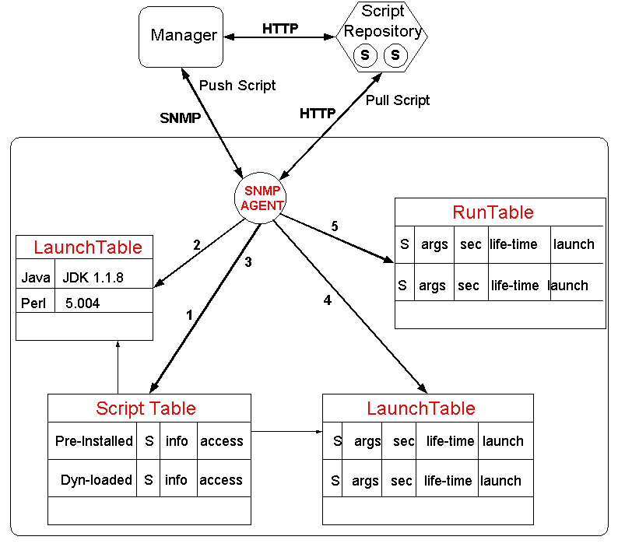
IETF Script MIB

Slide 31
Schedule MIB
Schedule MIB supports scheduling of actions periodically or at specified dates and times.
Periodic schedules are based on fixed time periods between the initiation of scheduled actions.
Calendar schedules trigger scheduled action at specified days of the week and/or days of the month.
One-shot Schedules are similar to calendar schedules. The difference is that a one-shot schedule will automatically disable itself once an action has been invoked.

Slide 32
Schedule MIB
schedMIB
{.iso.org.dod.internet.mgmt.mib-2 63}
schedNotifications
schedObjects
{schedMIB 2}
schedConformance
{schedMIB 1}
{schedMIB 3}
schedTraps
schedLocalTime
schedTable
schedActionFailure
schedOwner
schedVariable
schedName
schedValue
schedDescr
schedType
schedInterval
schedAdminStatus
schedWeekday
schedOperStatus
schedMonth
schedFailures
schedDay
schedLastFailure
schedHour
schedLastFailed
schedMinute
schedStorageType
schedContextName
schedRowStatus
schedTriggers

Slide 33
Expression MIB
Users of MIBs often desire MIB objects that MIB designers have not provided.
Rather than fill more and more MIBs with standardized objects, the Expression MIB supports externally defined expressions of existing MIB objects.
Expression MIB is a way to create new, customized MIB objects for monitoring.
Without these capabilities monitoring would be limited to the objects in predefined MIBs.
The Expression MIB has become a powerful tool for the network manager for monitoring large, complex systems.

Slide 34
Expression MIB – Structure
Resource Section
Has objects to manage resource usage by wildcarded delta expressions, a potential major consumer of CPU and memory.
Definition Section
Contains the tables that define expressions.
The expression table contains parameters that apply to the entire expression, such as the expression itself, the data type of the result, and the sampling interval if it contains delta or change values.
The object table contains the parameters that apply to the individual objects that go into the expression, including the object identifier, sample type, discontinuity indicator, and such.
Value Section
Contains the values of evaluated expressions.
For a given expression only one of the columns is instantiated, depending on the result data type for the expression. The instance fragment is a constant or the final section of the object identifier that filled in a wildcard.

Slide 35
Expression MIB - Structure
dismanExpressionMIB
{.iso.org.dod.internet.mgmt.mib-2 90}
dismanExpressionMIBObjects
dismanExpressionMIBConformance
{dismanExpressionMIB 1}
{dismanExpressionMIB 2}
expDefine
expValue
expResource
expValueTable
expErrorTable
expExpressionTable
expObjectTable

Slide 36
Section 3 Service Level Monitoring

Slide 37
Measuring Network Delay, Jitter, and Packet-loss
Multi-media applications are sensitive to the transmission characteristics of data networks.
The delay, jitter, and packet loss measurements can aid in the correct design and configuration of traffic prioritization, as well as buffering parameters in the data networking equipment.

Slide 38
Definitions
Delay
time taken for packets to travel across a network.
One-way delay calculations require clock synchronization across nodes, whereas measuring round-trip delay is easier and requires less expensive equipment.
Jitter
is the variation in delay over time.
A jitter buffer temporarily stores arriving packets in order to minimize delay variations.
The more jitter buffer available, the more the network can reduce the effects of jitter.
Packet loss
the percentage of packets transmitted over the network that did not reach their intended destination

Slide 39
Cisco IP SLA
Cisco IOS IP SLA enables measurement of jitter, latency, or packet loss between any two points in the network.
IP Services can be simulated by specifying various packet sizes, ports, class of service, packet spacing, and measurement frequencies.
Measurements per class of service to validate service differentiation for data, voice, and video.
Cisco IP SLA helps to establish a network performance baseline and allow the user to understand trends and anomalies from the baseline.

Slide 40
SAA and RTTMON
Cisco IP SLA is supported by the Service Assurance Agent (SAA) and the Round-Trip Time Monitoring (RTTMON) MIB.
The SAA and the RTTMON MIB are Cisco IOS software features available in versions 12.0 and higher.
The features enable you to test and collect delay, jitter, and packet loss statistics on the data network.
Delay, jitter, and packet loss can be measured by deploying small Cisco IOS routers as probes to simulate customer end stations.
The probes can be configured to monitor the network for delay and jitter service levels and alert network management stations when a threshold is exceeded.

Slide 41


SLAs for IP Networks
SP Converged IP Network
Measure Either CE–PE or CE–CE Links
P Router
Enterprise
Site 1
Enterprise
Site 2
Measure Either
PE–CE or PE-PE Links

Slide 42
Cisco IP SLA: Source and Responder
Source Router
Configuration for each operation
Cisco IOS router sends test packets for each operation
Cisco IOS router may or may not be the target
Some operations require the target to run the IP SLA responder
Stores results in the RTTMON MIB
Responder
Responds to IP SLA packets at destination
User defined UDP/TCP ports
Accurate measurements

Slide 43
UDP Jitter Operation
Send train of packets with
constant Interval
Receive train of packets at
Interval impacted by Network
IP Core
Source
Responder
Add a receive time stamp, and calculate delta, the processing time.
Per-direction inter-packet delay (Jitter)
Per-direction packet loss
Average Round Trip Delay

Slide 44
Polling the RTTMON MIB
The delay and jitter probes begin data collection and place data in RTTMON SNMP MIB tables.
rttMonStatsTable
provides average of all the jitter operations for the last hour.
rttMonLatestJitterOper
provides the values of the last operation completed.
‘show rtr collection−stats’

Slide 45
Section 4 NNM Scalability and Distribution

Slide 46
NNM Scalability and Distribution
Distribution of NNM is
an approach is to distribute the network management workload to multiple, usually remote, systems.
Scalability is referred to
the configuration of NNM to perform well for a wide range of network sizes and degrees of complexity.
Optimizes the use of two key resources:
System resources at the management station.
Reduce the amount of management traffic over the network.

Slide 47
NNM Scalability & Distribution Features
Distributed Discovery and Monitoring
Management Consoles
On-demand Sub-maps
Object Filtering
Event Forwarding
Distributed Threshold Monitoring

Slide 48
NNM Distributed Discovery and Monitoring
Ability to move much of the network discovery, topology monitoring, and status polling from the management station to one or more remote nodes.
Consists of Management and Collection stations
Management station makes network management functions available to users.
Collection stations function as data collection points. A collection station typically performs:
network discovery
topology checks and status monitoring
data collection
event forwarding

Slide 49
NNM Distributed Internet Discovery & Monitoring
Changes in status and topology are relayed from the collection
stations to the management station.
Managed Devices
Management
Station A
Discovery and status polling occur at the local level.
Collection
Station A
Collection
Station B
Collection
Station n
Managed Devices
Managed Devices
Managed Devices

Slide 50
NNM Filters
A filter is a way to remove unneeded data from further processing.
Filters result in less data to process, higher NNM performance, and improved usability for the operators.
Filter Type | Purpose | Apply on incoming data | Reevaluate if filter changes | Applied so data is
Discovery | Limit scope of Objects added to database. | Yes | No | Excluded
Topology | Limit information forwarded from collection station to management station. | Yes | Yes | Excluded
Map | Show only items of interest to operator on map. | Yes | Yes | Included
Failover | Limit nodes polled by management station when collection station fails. | Yes | Yes | Included

Slide 51
NNM Distributed Internet Discovery & Monitoring
Domain A Devices
NNM
Adv Edition A
NNM
Adv Edition B
NFS
NFS
Domain B Devices
LAN data flow
WAN data flow
Filter in data path
NNM Station C
Dual-role station
NNM Station D
Collection station
NNM Station E
Collection station
NNM Station F
Dual-role station
Objects discovered & monitored by Station D
Objects discovered & monitored by Station F
Objects discovered & monitored by Station E
Objects discovered & monitored by Station C

